Slide 1
Performance Management: Annual Review
December and January
Notes:
Total Slide Time: 5 minutes
Welcome participants to this webinar on the Performance Review Meeting.
Explain this webinar is designed to help them be successful during the review meeting by providing them with the process steps and best practice tips.
Explain that this tool along with others (Performance Management FAQs, Giving Feedback, and the Performance Management Approach and Checklist) can be accessed via the eLU (see next slide).

Slide 2
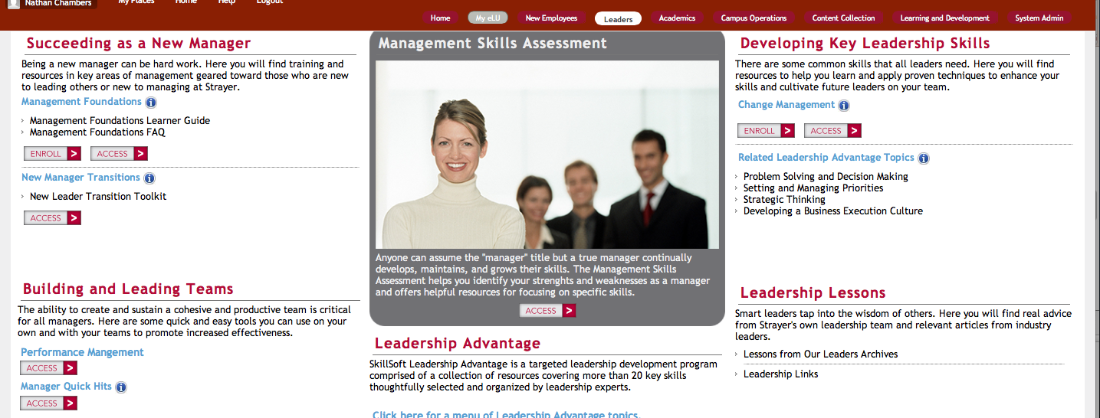
eLU – Performance Management Toolkit
Notes:
Total Slide Time: 3 minutes
Explain that the Performance Management Toolkit can be accessed via the eLU by going to the Leaders tab at the top, then accessing Performance Management as depicted by the orange rectangle.

Slide 3
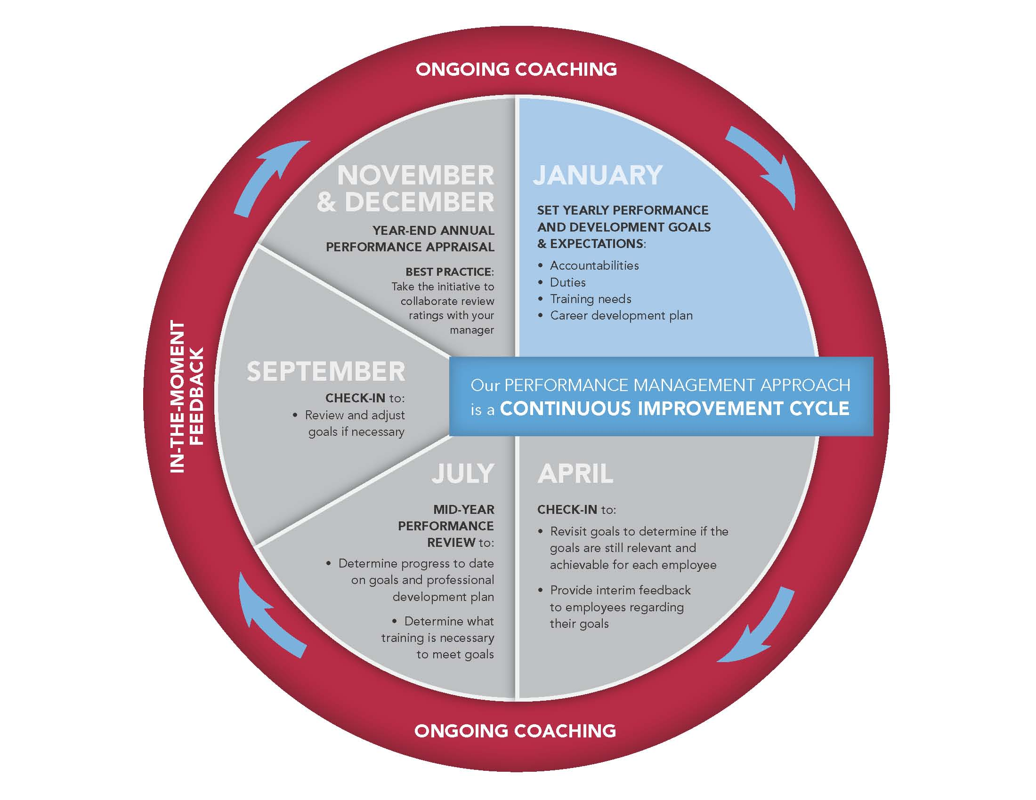
Reinvention Needed – The Old Site
Strategy
One-on-ones: Conduct bi-weekly one-on-ones with each employee to review feedback and observations.
Manager-as-coach: Provide as much on-the-job coaching during the week to provide positive and constructive feedback in the moment of action.
Notes:
Total slide time: 5-8 minutes.
Discuss each part of the process as it is displayed on the graphic.
Explain where we are in the process (January section).
Explain what should have been completed by now – employee self-review and manager review.
Discuss the ground rules:
Sensitive information needs to go offline with an employee relations specialist
Feel free to speak up to ask questions at anytime during this webinar, goal is to make it about you

Slide 4
The Performance Review Meeting
Before
During
After
Notes:
Total Slide Time: 8 minutes
Before the Meeting
Explain that they are about to hold your performance review meetings.
Discuss how to prepare for the meeting.
Important Webinar Note: this polling question needs to be built within WebEx prior to conducting the meeting (polling question – how many of you partnered with your manager or ER to corroborate your review of each employee – briefly review results – explain it’s a best practice)

Slide 5
The Performance Review Meeting
Before
During
After
Notes:
Total Slide Time: 5 minutes
During the Meeting
Discuss what should be done during the meeting (provide meaningful feedback with examples, ensure it is a two-way conversation, anticipate rating disagreement (high or low)).
Explain any difference in their rating versus the manager rating; this is critical to ensure they know how to improve to achieve the rating they want and to understand why you might have rated them higher than they rated themselves.
Important Webinar Note: this polling question needs to be built within WebEx prior to conducting the meeting (polling question – how many have a hard time discussing differences between the employee and the manager rating – discuss example approaches)
Find out what questions the employee has about the review.
Discuss agreed upon SMART goals for next year following the annual review form to determine the What, When, and How of achieving the goal(s). Explain that these can be accomplished a few ways: (1) the What, When, and How section of the annual review form and (2) the My eLU tab contains a great resource called “Building a Plan” that includes a tool to help them list out the respective “whats, whens, and hows” of a development plan. Discuss how they can use the eLU as a tool to identify various tools and resources to achieve their development plans. Note: you may want to show them the tool within the eLU.
Discuss the developmental plan and the use of the eLU in accomplishing their plan.
Discuss follow-up meeting within two-weeks to finalize goals and development plan.

Slide 6
The Performance Review Meeting
Before
During
After
Notes:
Total Slide Time: 8 minutes
After the Meeting
Explain how to submit the completed review.
Explain how and why to develop a personal plan for performance management throughout the year.
Explain how and why to assist their employees with developing and implementing their personal development plan.

Slide 7
Best Practices Q&A
Best Practice Tip
Best Practice Tip
Best Practice Tip
Best Practice Tip
Best Practice Tip
Notes:
Total Slide Time: 20 minutes
Explain the top five best practices (need list)
Find out what questions anyone has regarding performance management.

Slide 8
How can you help?
Promote a Culture of Learning
Beyond Mandatory Training
70
20
10
Connect Your Employees to Useful Resources that Drive Improved Performance, Productivity and Development
Be a Role Model:
Find Resources for Your Own Growth & Development - In the Spirit of Continuous Improvement
Find a New Topic of Interest Each Month to Highlight for Your Team
Notes:
Discuss the following to illustrate how managers can help with employee performance.

